Slide 1
Recursion in C
Dr. Shuaib Khan
Department of Computer Science and Engineering
Chitkara University, Punjab

Slide 2
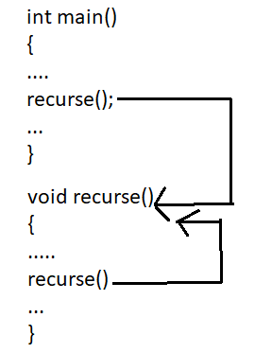
RECURSION
The process of calling a function itself is called as Recursion
Any function which calls itself is called recursive function, and such function calls are called recursive calls.
Recursion continues until some condition is met to prevent it.

Slide 3
RECURSION
Create a C program to calculate the factorial of given number using the recursion.
INPUT:
Enter the number for factorial: 5
OUTPUT:
The factorial of given number is: 120
LOGIC:
Read a;
Declare a recursive function fact()
Define fact() to recursively call fact()
Call fact() in main

Slide 4
Example -RECURSION:
//PROGRAM FOR FINDING THE FACTORIAL OF GIVEN NUMBER USING FUNCTION
#include <stdio.h>
int fact (int n); //function declaration and n is the formal parameter
int main()
{
int n,f;
printf("Enter the number ");
scanf("%d",&n);
f = fact(n);
printf("factorial = %d",f);
}
int fact(int n)
{
if(n==0 || n==1)
return 1;
else
return n*fact(n-1);
}

Slide 5
RECURSION
Create a C program to calculate the sum of n Natural Numbers using the recursion.
INPUT:
Enter n : 3
OUTPUT:
The sum of Natural Numbers : 6
LOGIC:
Read a;
Declare a recursive function sum()
Define sum() to recursively call sum()
Call sum() in main()

Slide 6
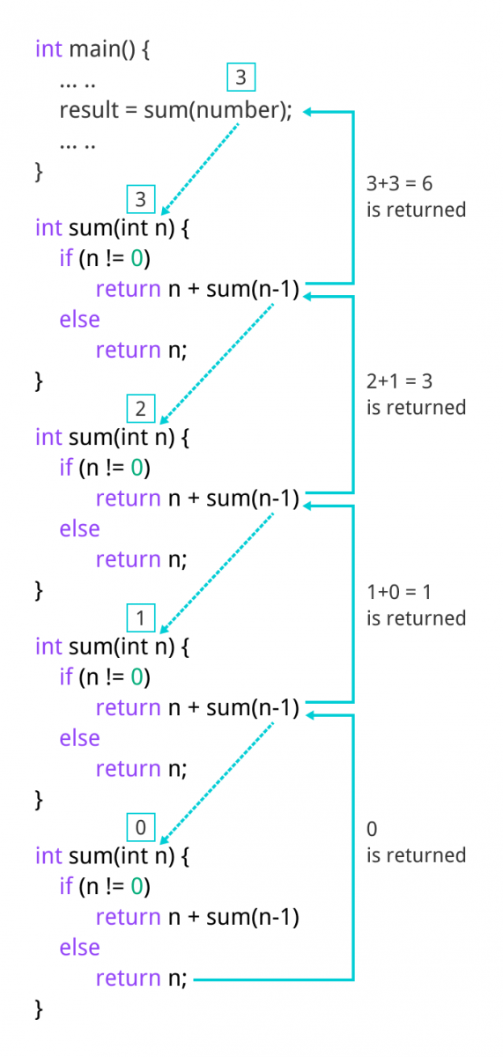
Example -RECURSION:
//program to find the sum of Natural Numbers Using Recursion
#include <stdio.h>
int sum(int n);
int main() {
int number, result;
printf("Enter a positive integer: ");
scanf("%d", &number);
result = sum(number);
printf("sum = %d", result);
return 0;
}
int sum(int n)
{
if (n != 0)
return n + sum(n-1); // sum() function calls itself
else
return n;
}

Slide 7
RECURSION
Create a C program to calculate the FIBONACCI SERIES using the recursion.
INPUT:
Enter n : 6
OUTPUT:
The Fibonacci series is : 0 1 1 2 3 5
LOGIC:
Read n;
Declare a recursive function fib()
Define fib(n) to recursively call n*fin(n-1)
Call fib() in main()

Slide 8
Example -RECURSION:
//PROGRAM FOR FIBONACCI SERIES
#include<stdio.h>
void fib(int n)
{
int n1=0,n2=1,n3;
if(n>0)
{
n3 = n1 + n2;
n1 = n2;
n2 = n3;
printf("%d ",n3);
fib(n-1);
}
}
int main(){
int n;
printf("Enter the number of elements: ");
scanf("%d ",&n);
printf("Fibonacci Series: ");
printf("%d %d ",0,1);
fib(n-2); //n-2 because 2 numbers are already printed
return 0;
}

Slide 9
RECURSION
Q) Write a c program to find the GCD of two numbers using recursion
INPUT:
Enter two numbers: 36 48
OUTPUT:
GCD of 36 and 48 is 12
LOGIC:
Read n;
Declare a recursive function gcd()
Define gcd(n) to recursively call gcd(n-1)
Call gcd() in main()

Slide 10
Example -RECURSION:
//PROGRAM TO FIND THE GCD OF TWO NUMBERS USING RECURSION
#include <stdio.h>
int gcd(int a, int b)
{
if (b == 0) {
return a;
}
return gcd(b, a % b);
}
int main()
{
int num1, num2;
printf("Enter two numbers: ");
scanf("%d %d ", &num1, &num2);
int result = gcd(num1, num2);
printf("GCD of %d and %d is %d\n", num1, num2, result);
return 0;
}

Slide 11
RECURSION- ADVANTAGES
Recursive functions are very useful to solve many mathematical problems, such as calculating the factorial of a number, generating Fibonacci series, etc
To solve such problems which are naturally recursive.
Reduce unnecessary calling of function.
Extremely useful when applying the same solution.
Recursion reduce the length of code.
It is very useful in solving the data structure problem
Disadvantages of recursion
Recursive functions are generally slower than non-recursive function.
It may require a lot of memory space to hold intermediate results on the system stacks.
Hard to analyze or understand the code.
It is not more efficient in terms of space and time complexity

Slide 12
RECURSION
Q) Write a c program to find the sum of the digits of a number using recursion
Input:
Enter a number: 12345
Output:
Sum of digits of 12345 is 15

Slide 13
Example -RECURSION:
//PROGRAM TO FIND THE SUM OF THE DIGITS OF A NUMBER
#include <stdio.h>
int sumOfDigits(int num)
{
if (num == 0) {
return 0;
}
return (num % 10) + sumOfDigits(num / 10);
}
int main()
{
int num;
printf("Enter a number: ");
scanf("%d", &num);
int result = sumOfDigits(num);
printf("Sum of digits of %d is %d\n", num, result);
return 0;
}

Slide 14
RECURSION
Q) Write a c program to reverse an array using recursion
Input:
Enter the size of array: 5
Enter the elements of array: 1 2 3 4 5
Output:
Original array: 1 2 3 4 5
Reversed array: 5 4 3 2 1

Slide 15
#include <stdio.h>
void reverseArray(int arr[], int start, int end)
{
if (start >= end) {
return;
}
int temp = arr[start];
arr[start] = arr[end];
arr[end] = temp;
reverseArray(arr, start+1, end-1);
}
int main()
{
int size;
printf("Enter the size of array: ");
scanf("%d", &size);
int arr[size];
printf("Enter the elements of array: ");
for (int i = 0; i < size; i++) {
scanf("%d", &arr[i]);
}
printf("Original array: ");
for (int i = 0; i < size; i++) {
printf("%d ", arr[i]);
}
reverseArray(arr, 0, size-1);
printf("\nReversed array: ");
for (int i = 0; i < size; i++) {
printf("%d ", arr[i]);
}
printf("\n");
return 0;
}

Slide 16
RECURSION
Q) Write a program to reverse a given string using recursion
Input: "hello"
Output: "olleh"
Input: "world"
Output: "dlrow"

Slide 17
#include <stdio.h>
#include <string.h>
void reverse(char *str, int start, int end)
{
if (start >= end)
return;
else
{
char temp = str[start];
str[start] = str[end];
str[end] = temp;
reverse(str, start+1, end-1);
}
}
int main()
{
char str[100];
printf("Enter a string: ");
scanf("%s", str);
int n = strlen(str);
reverse(str, 0, n-1);
printf("Reversed string: %s", str);
return 0;
}

Slide 18
RECURSION
Q) Write a program to to print all the subsets of a given set of integers using recursion
Input: 3
1 2 3
Output:
{}
{ 3 }
{ 2 }
{ 2 3 }
{ 1 }
{ 1 3 }
{ 1 2 }
{ 1 2 3 }

Slide 19
#include <stdio.h>
void print_subset(int arr[], int n, int index, int subset[])
{
if (index == n)
{
printf("{ ");
for (int i = 0; i < n; i++)
{
if (subset[i] == 1)
printf("%d ", arr[i]);
}
printf("}\n");
}
else
{
subset[index] = 0;
print_subset(arr, n, index+1, subset);
subset[index] = 1;
print_subset(arr, n, index+1, subset);
}
}
int main()
{
int n;
printf("Enter the size of the set: ");
scanf("%d", &n);
int arr[n], subset[n];
printf("Enter %d integers for the set:\n", n);
for (int i = 0; i < n; i++)
scanf("%d", &arr[i]);
printf("Subsets:\n");
print_subset(arr, n, 0, subset);
return 0;
}

